Slide 1
SECURE DATA HIDING IN IMAGES USING STEGANOGRAPHY
CAPSTONE PROJECT
Presented By : Padmapriya Chenchamgari
Student Name : Padmapriya Chenchamgari
College Name & Department : Visvodaya Engineering College & CSE

Slide 2
OUTLINE
Problem Statement
Technology used
Wow factor
End users
Result
Conclusion
Git-hub Link
Future scope

Slide 3
Problem Statement
Design a steganographic technique to embed encrypted data within digital images without perceptible visual changes. The method must ensure high security against unauthorized extraction, maintain the original image's integrity, and resist steganalysis detection. Challenges include optimizing data capacity, preserving visual quality, and balancing robustness against distortions. The goal is a secure, efficient solution that conceals information while remaining undetectable under scrutiny.

Slide 4
Technology used
Python 3.9 – Programming Language
OpenCV – Used for image processing, reading, writing images
OS Module – Handles file system operations
String Module – For Character processing and generating text-based keys
Cryptography Library – For encrypting the hidden data before embedding it

Slide 5
Wow factors
Advanced Security Features
Multiple File Support
Improved Steganography Techniques
Multi-Image Encoding
Two Layers of Security

Slide 6
End users
Individuals, Business Professionals, Cryptographers

Slide 7
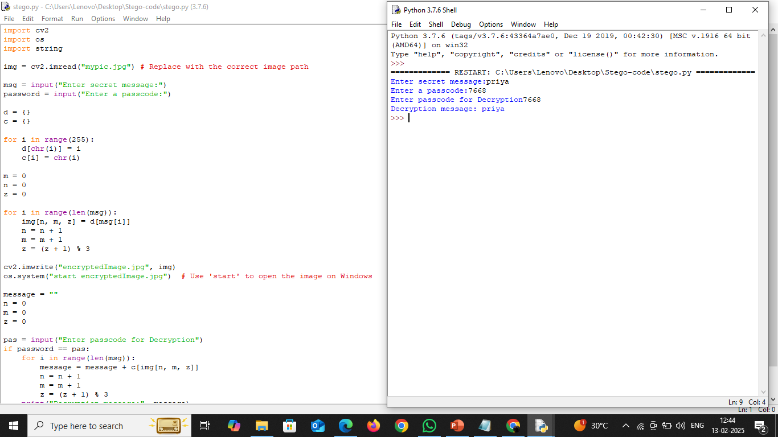
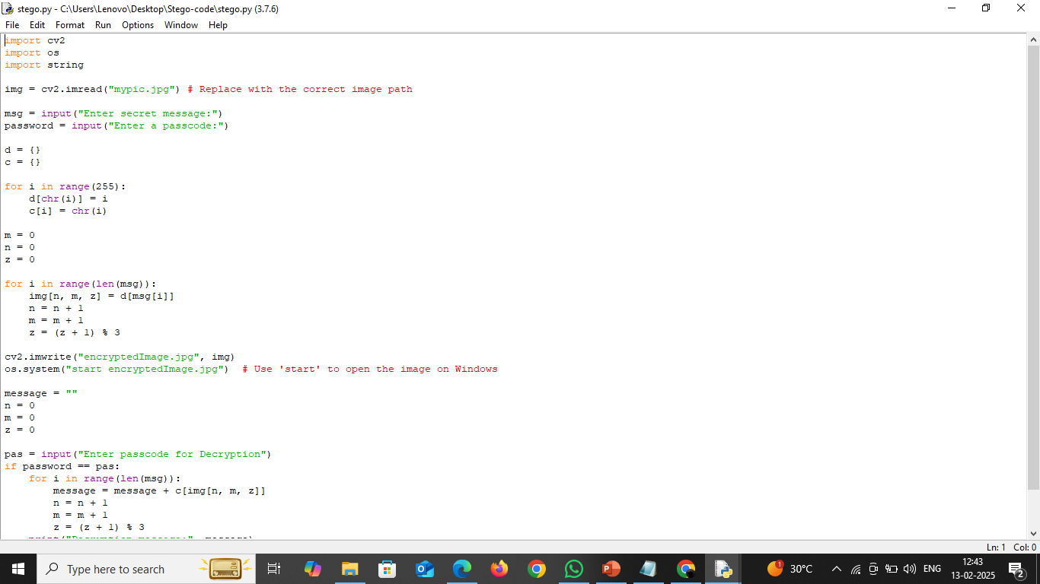

Results

Slide 8
Conclusion
This project successfully embeds encrypted data in images using steganography, ensuring security, visual integrity, and resistance to detection. By leveraging OpenCV, OS, and string manipulation, it optimizes data capacity while preserving image quality. Advanced techniques like AES encryption and adaptive LSB enhance security. The solution is practical for confidential communication and cybersecurity, with potential for extensions like video steganography and AI-based detection prevention.

Slide 9
GitHub Link
https://github.com/PadmaaaPriyaaa/Secure-Data-Hiding-in-images-using-Steganography

Slide 10
Future scope
The Secure Data Hiding in Images Using Steganography project holds significant potential for future advancements in response to evolving cyber threats and data security concerns. Key areas for development include integrating stronger encryption techniques like AES and RSA to enhance security, incorporating AI and machine learning for adaptive steganographic methods that minimize detection risk, and expanding the scope to include multi-format steganography across videos, audio, and documents. Additionally, the creation of a cloud-based steganography system could facilitate secure data hiding, retrieval, and sharing over encrypted cloud storage, further increasing the versatility and effectiveness of the technique

Slide 11
THANK YOU

